Slide 1
CMOS Inverter Design and Analysis
Submitted By
Madhumitha M
Department of Electronics and Communication Engineering (ECE)
VLSI

Slide 2
Introduction
A CMOS (Complementary Metal Oxide Semiconductor) inverter is the most fundamental building block of digital integrated circuits. It consists of one PMOS transistor and one NMOS transistor connected in a complementary configuration.
CMOS technology is widely used in modern electronic systems because of its low power consumption, high noise immunity, and efficient switching characteristics.
The inverter performs the basic logic operation of converting a logic HIGH input into a logic LOW output and vice versa.
02 / 08

Slide 3
Objectives
Design a CMOS inverter using PMOS and NMOS transistors.
Measure the propagation delay between input and output signals.
Simulate the circuit using LTspice software.
Study the effect of transistor sizing on circuit performance.
Analyze the switching characteristics of the inverter.
Validate the inverter operation through simulation results.
03 / 08

Slide 4
Technology Used
Software
Components
Analysis Performed
PMOS Transistor
NMOS Transistor
DC Voltage Supply (VDD = 5V)
Pulse Voltage Source
Ground Terminal
Transient Analysis
Delay Measurement
Performance Evaluation
LTspice Simulation Software
04 / 08

Slide 5
Methodology
1
Designed the CMOS inverter circuit using PMOS and NMOS transistors.
5
Performed transient simulation using LTspice.
2
Connected the PMOS transistor between VDD and output node.
6
Observed input and output waveforms.
3
Connected the NMOS transistor between output node and ground.
7
Measured propagation delay using cursor analysis.
4
Applied a pulse signal as the input voltage.
8
Evaluated inverter performance and validated results.
Design Flow
Circuit Design → Component Connection → Input Signal Setup → LTspice Simulation → Waveform Analysis → Delay Measurement → Performance Validation
05 / 08

Slide 6
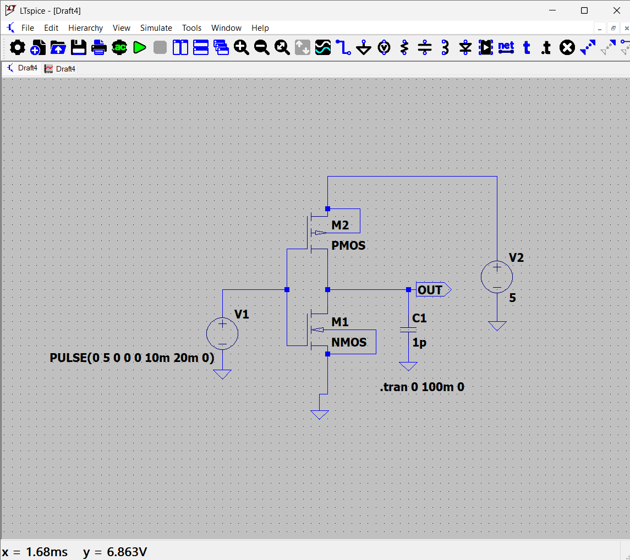
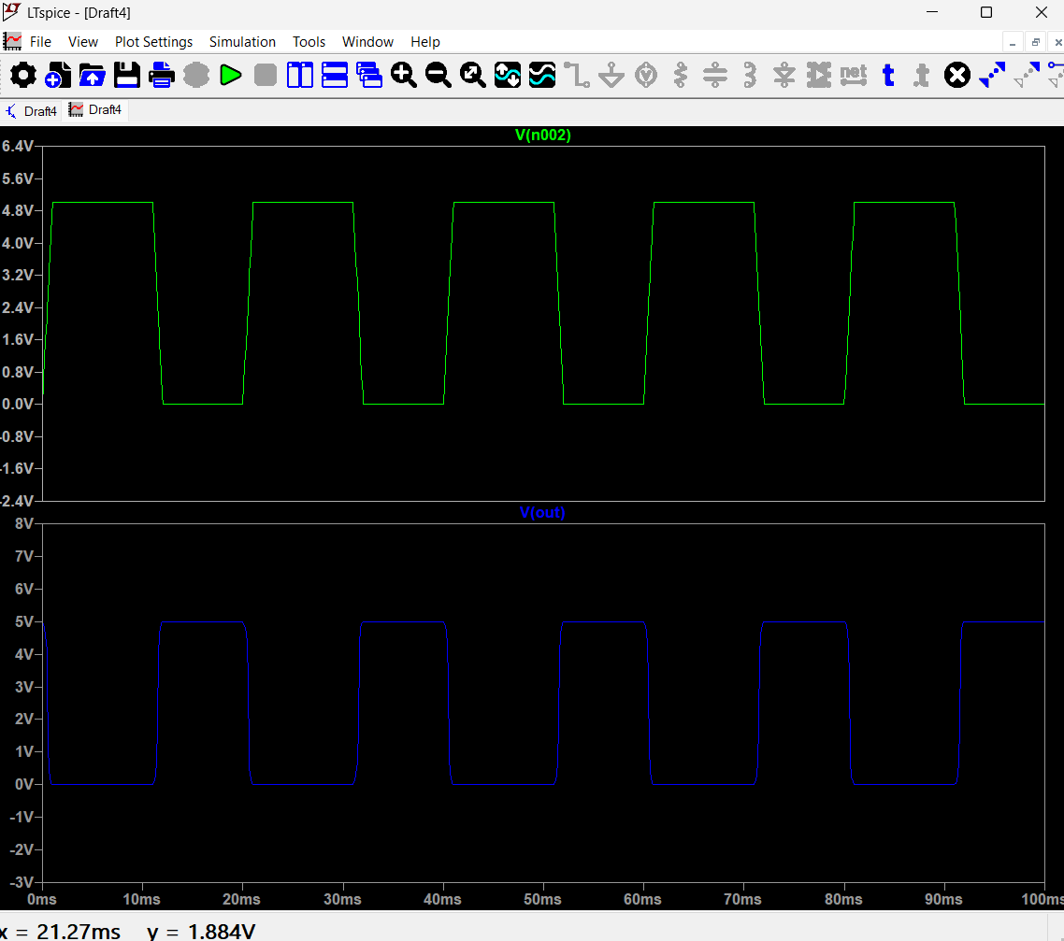
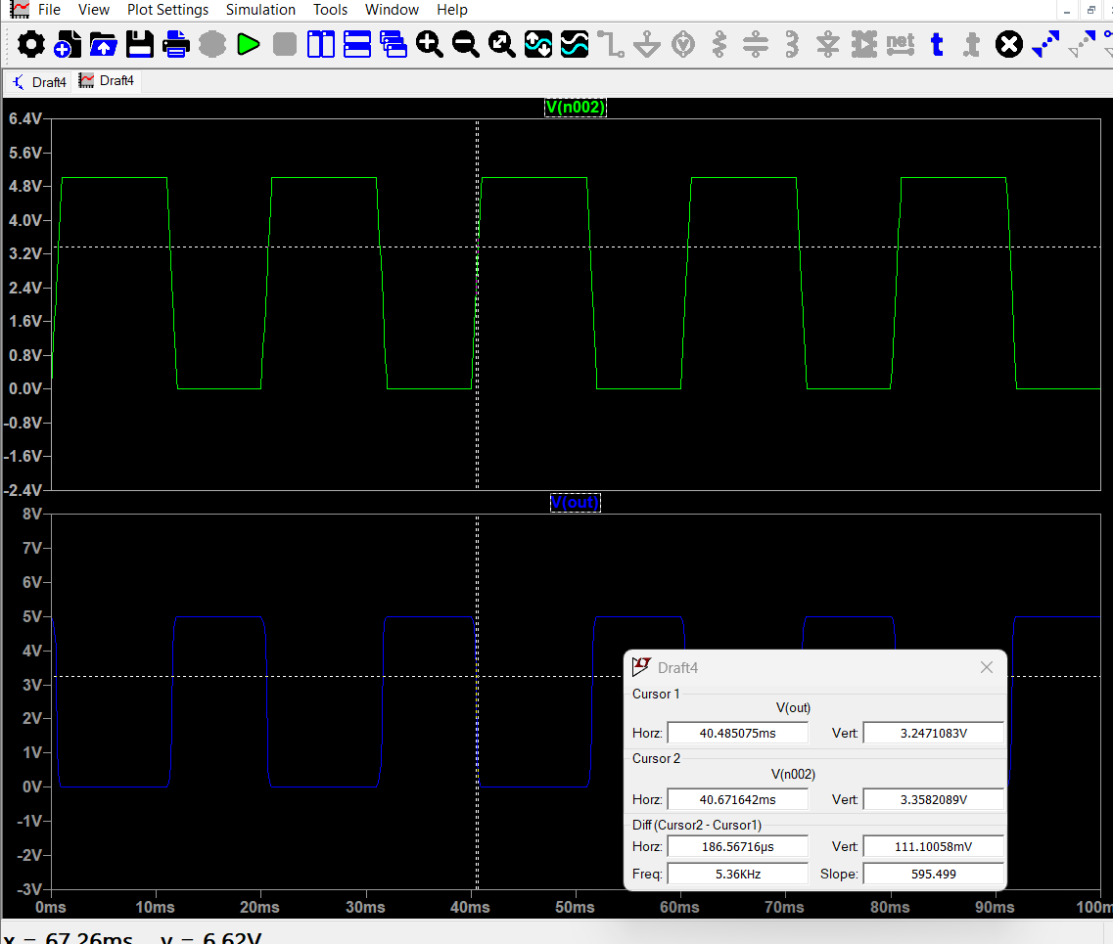
Output / Result
CMOS Inverter Circuit
Input / Output Waveforms
Observations
Delay Measurement
When Vin = 0V → Vout = 5V
When Vin = 5V → Vout = 0V
Propagation delay measured using LTspice cursors:
tpd ≈ 186.57 µs
Figure: Propagation delay measurement using LTspice cursor analysis
06 / 08

Slide 7
Conclusion
The CMOS inverter was successfully designed and simulated using LTspice software.
The simulation results confirmed that the output is always the logical complement of the input, demonstrating proper inverter operation.
Propagation delay was measured and the switching characteristics were analyzed.
The project highlights the importance of CMOS technology in digital circuit design due to its low power consumption and efficient performance.
Thus, the objectives of the project were successfully achieved.
07 / 08

Slide 8
Thank You
Madhumitha M
Department of Electronics and Communication Engineering (ECE) · VLSI
08 / 08

